Slide 1
Digital Advertising in WA State Elections
Josh Amato & Erin Schultz
Sermo Digital NWP Consulting
Presentation to the Public Disclosure Commission
January 16, 2020

Slide 2
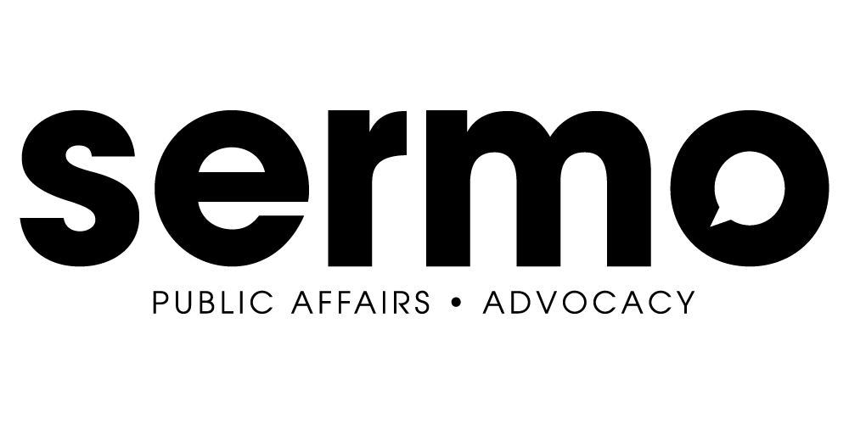
About Us
Notes:
Joint
A lot of the focus has been around Facebook & Google, but they are just two of the players at this point in time. While they are both powerful ways of reaching voters, they are not the only way. Regulations governing digital advertising should focus on the industry as a whole and how the industry functions — not specific features of some platforms. The reason most of the laws for disclosure worked up until internet advertising become popular is because they were focused on the industry — not a specific television channel’s format. It would be beneficial to consider Online as if it were TV, with Google, Facebook, Twitter, SeattleTimes.com, and any other website as just a channel available to users.
One of the great benefits of Online advertising is “Programmatic” advertising — the ability for us to bid on a specific voter that fits our criteria. A simplified version of this is something that Comcast has made limitedly available in Washington, and we can expect to grow. How can our regulations fit the advertising industry long-term while truly allowing for transparency? Hopefully our presentation will help shed some light on that question.

Slide 3
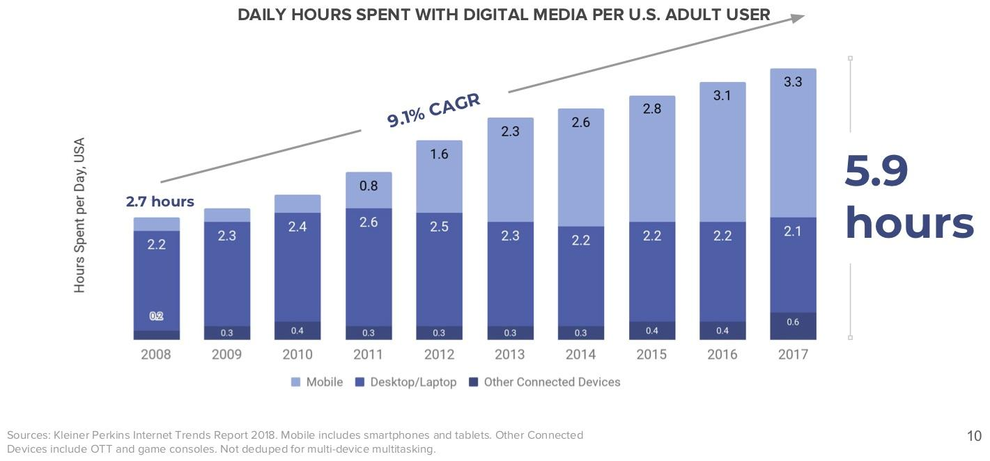
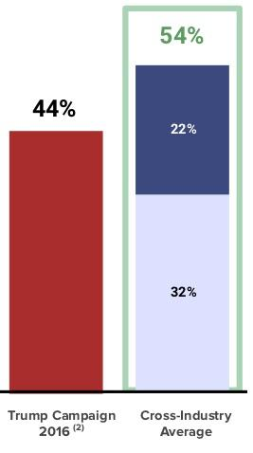
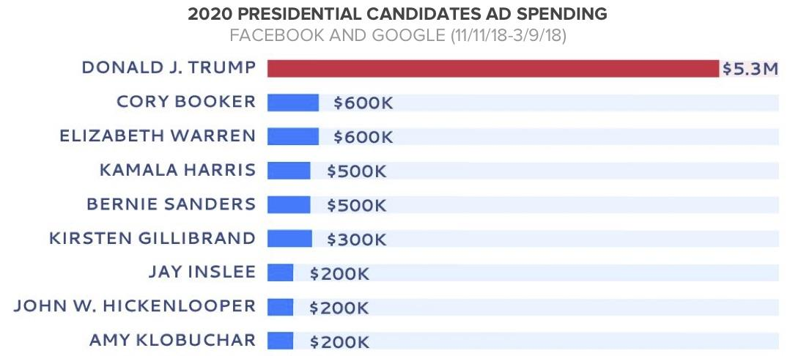
Increasing Importance of Digital Advertising in Campaigns
Notes:
Erin - Impossible to educate voters about candidates or issue campaigns without being able to communicate with them online given that adults spend so much time online. Reaching younger voters is virtually impossible in any other format (address changes, PO Boxes, no landlines, streaming radio, streaming tv, etc.)
The business world knows this -- that is why they are spending 54% of their media spend is devoted to digital advertising and the Trump campaign in 2016 spent 44% of their media budget on digital ads.
Looking forward to the 2020 election we see that digital advertising remains an essential tool of campaigns to reach and connect with voters.

Slide 4
Benefits of Digital Advertising in Local Elections
COST TARGETING
DATA TURNAROUND
Notes:
Erin - Josh and I agree that in many ways digital advertising has an even more important role in state and local candidate and issue elections for a few key reasons.
Cost - While larger campaigns have resources to invest on broadcast and cable tv, direct mail, etc., digital advertising low cost of entry means that smaller campaigns can communicate with voters for $10, $100, or $1,000.
The high costs of other mediums are in part based on the inability to target. Because you have to speak to all of viewers in a broadcast media market or cable zone for example the cost is extremely high. With digital advertising you can micro-target by vote propensity, geography, demography, etc and ensure you are making the most effective use of campaign dollars.
Larger campaigns have the ability to spend $30,000 on a poll or focus group, but smaller campaigns dont have that. With tv, direct mail, and radio there is also no ability to track performance, what messages are important to voters, and what messages voters are responding to, but digital advertising gives you that ability.
Campaigns spend months to a year raising the resources to communicate about their issue or candidacy and have a very limited window to communicate, primarily when ballots are out. The production and deployment times on tv and radio ads, printing and mailing direct mail, etc means there is little flexibility or ability to respond quickly to developments. Digital advertising can be live as soon as it is designed, posted and reviewed - usually within a matter of hours.

Slide 5
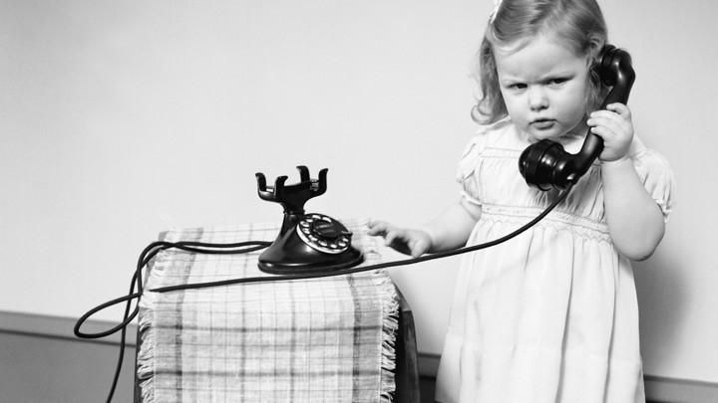
Placing Digital Ads 101
Direct Buy
Notes:
Josh
Publisher Run Ad Campaign
This might be done by contacting a Seattle Times or McClatchy sales rep, sending them the creative, then they run the ad on their website. The only information available to us is what they choose to give us in an agreed upon interval. In most cases, the targeting available on publisher run campaigns is very limited. However, Publisher Run ad campaigns are the only ones who can realistically comply with the book of business requirement -- at least in part because …
Advertiser Run Campaign via DealID
This is similar to a publisher-run campaign, but they provide us with a unique ID giving us direct access to their inventory through our buying platform. In this case, their reporting on our activity is more limited, they wouldn’t necessarily see the creative we’re running.

Slide 6
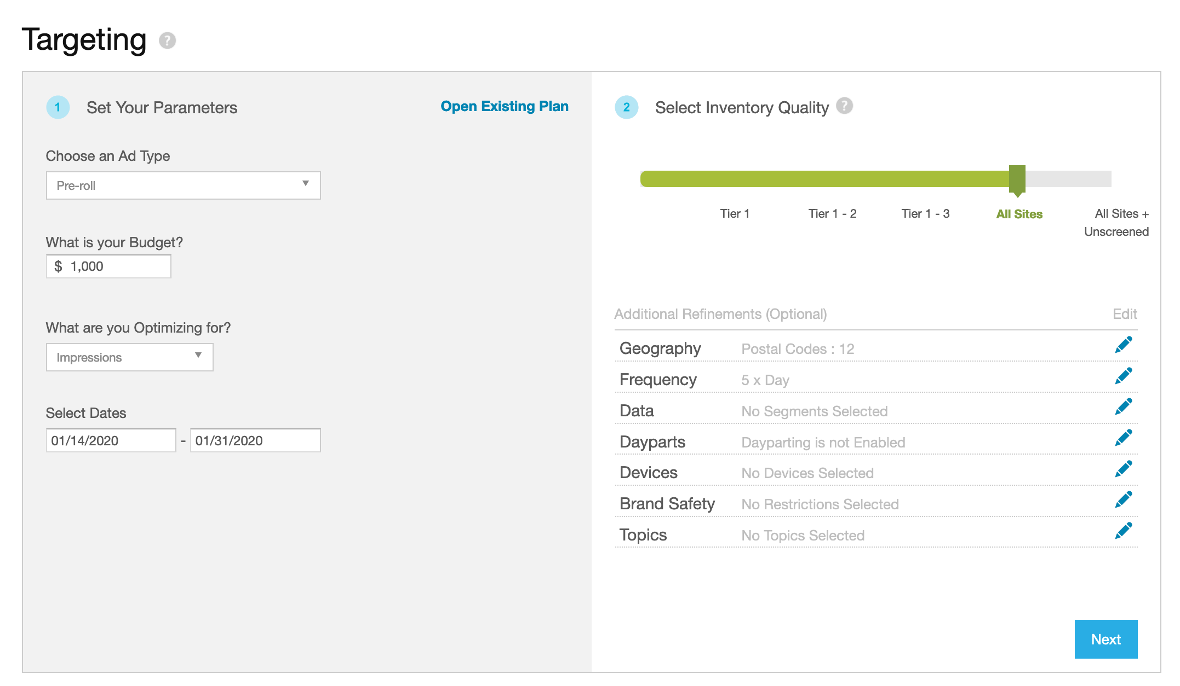
Placing Digital Ads 101
Auction Buying / Programmatic
Notes:
Josh
Auction or Programmatic Buying
I’m going to walk you through a very basic demonstration of how we might target voters using Programmatic ad buying.
This is an overview of what we might see when doing forecasting, which is a way of estimating what kind of impressions we might get based on our targeting criteria. We can target by location, data segments, devices, and on topics like “taxes” or “car tabs”. We can also limit targeting to time, on websites that display sensitive material, and by broad demographics like age, gender, etc. The broad demographics can be part of data segments, depending on the platform.

Slide 7
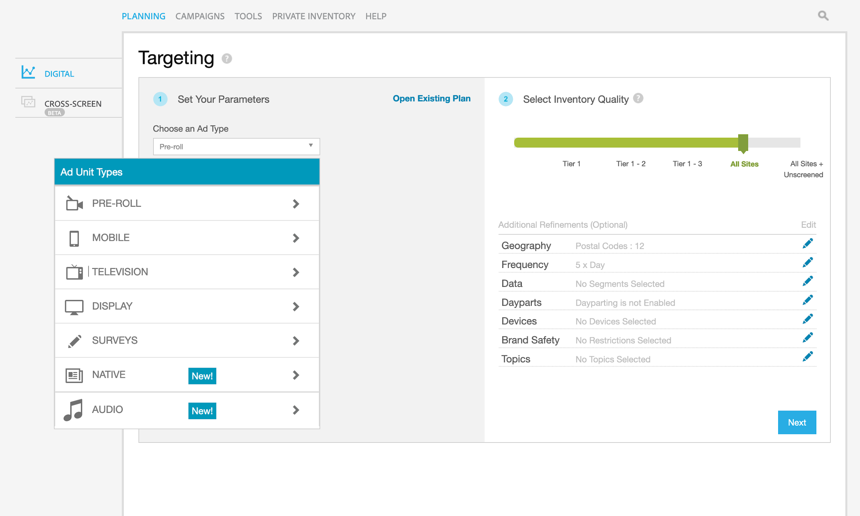
Placing Digital Ads 101
Auction Buying / Programmatic
Notes:
Josh
In the system we use we have the option of choosing many types of ads, from pre-roll, movile, TV (which is currently limited but the options are expanding), banner, surveys, native, and audio.

Slide 8
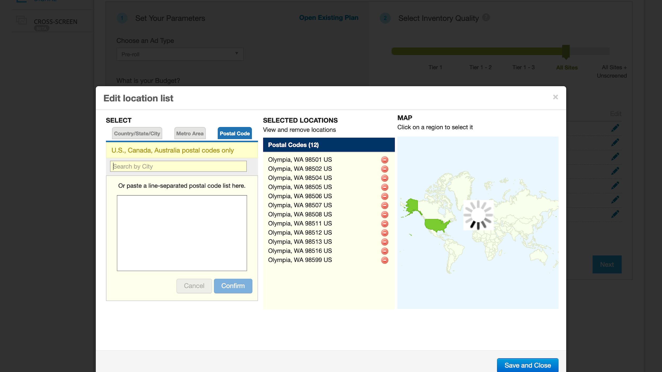
Placing Digital Ads 101
Auction Buying / Programmatic
Notes:
Josh
We can then choose geography. Geographic targeting options vary from system. We can go very broad or granular. In our system we can essentially draw our own lines on a map and target those areas. However, something we always have to consider is the ability for the ad buy to scale. Too small of a geo and the system has trouble finding people, which can result in an ineffective ad buy. In this instance I’ve chose to target Olympia.

Slide 9
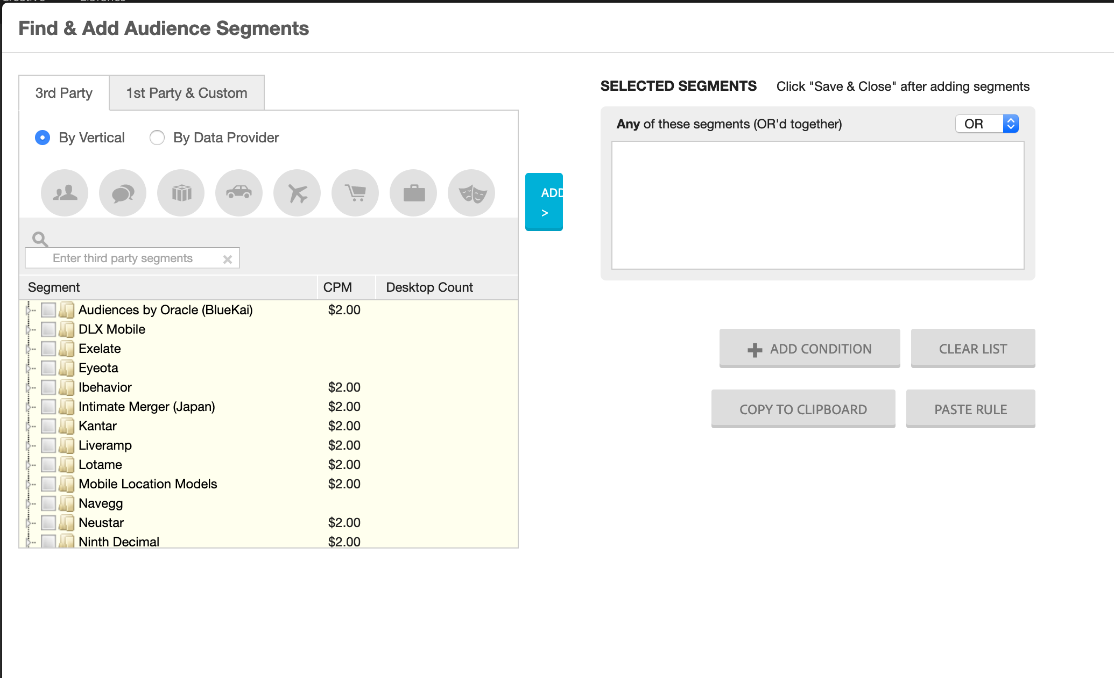
Placing Digital Ads 101
Auction Buying / Programmatic
Notes:
Josh
Next we can choose our data segments. Everything you are doing is tracked. The apps on your phones are reporting information about you. Your grocery store reward cards, your credit cards, warranties, magazine subscriptions. All that information is tracked and we have access to all of it right here. Now, it’s all anonymized. I don’t know that “John Smith” matches all these things.

Slide 10
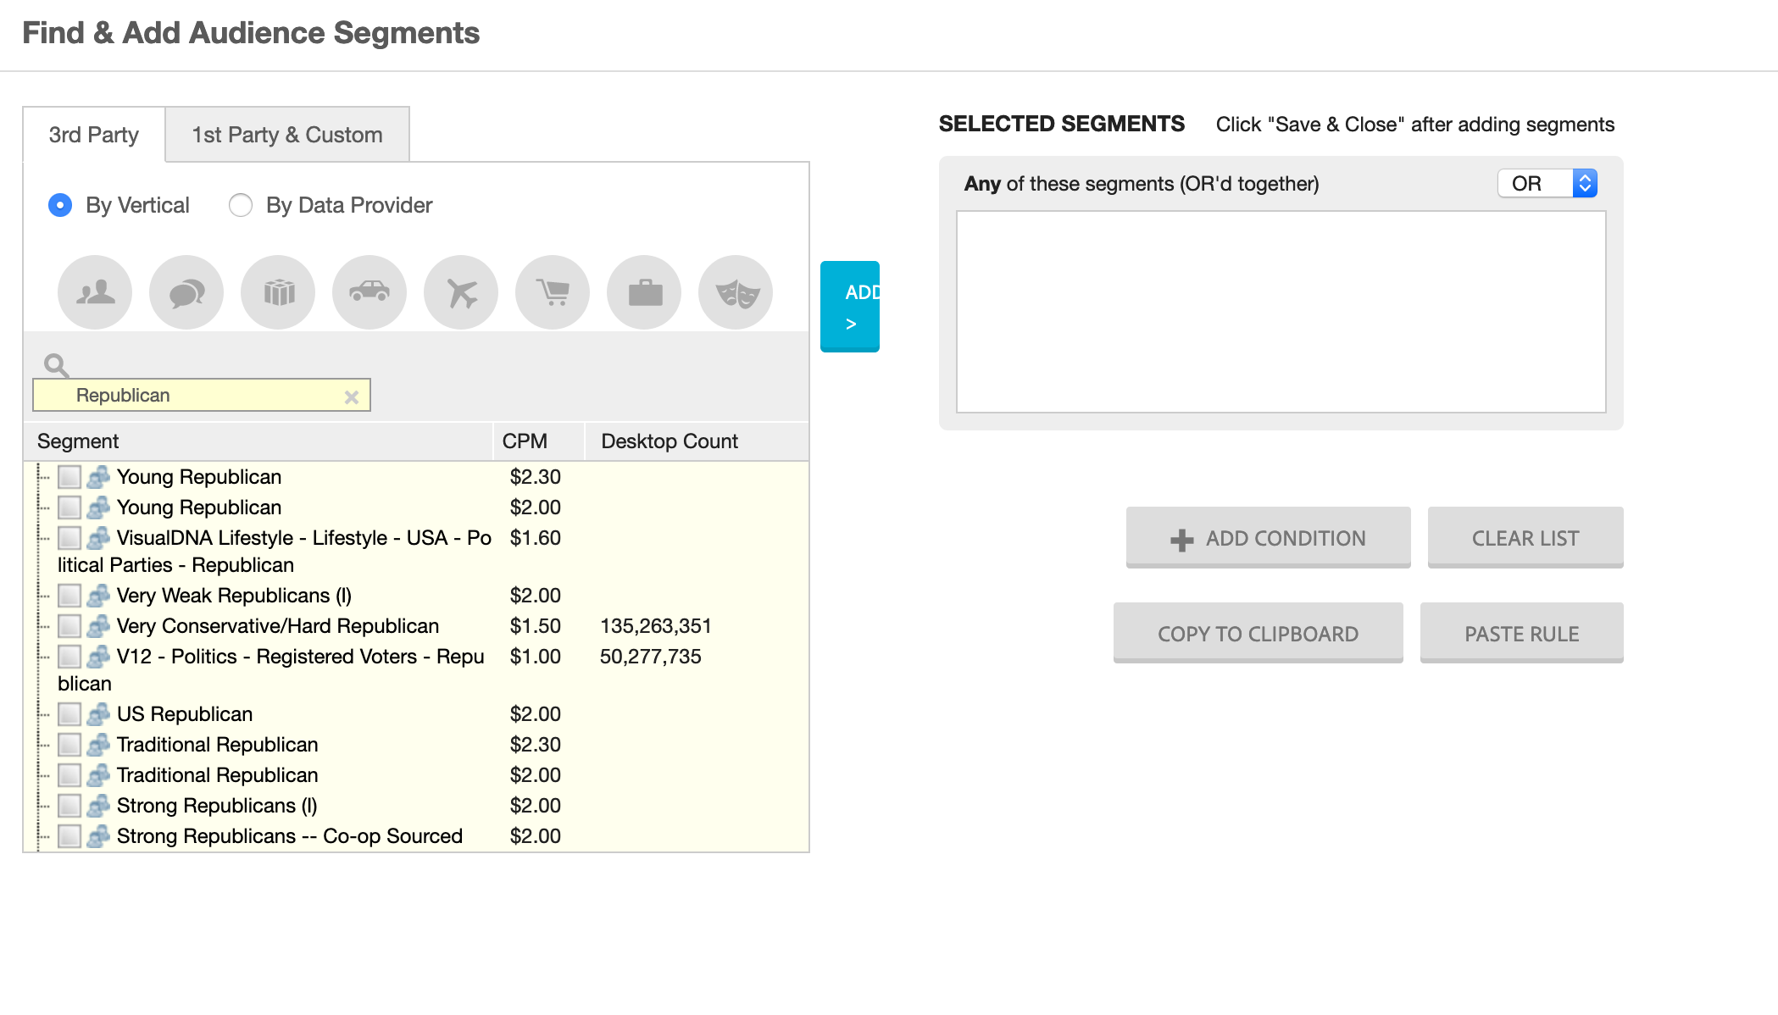
Placing Digital Ads 101
Auction Buying / Programmatic
Notes:
Josh
We can go very broad in our targeting, so we’ll grab all of the “Republican” segments that make sense for us.

Slide 11
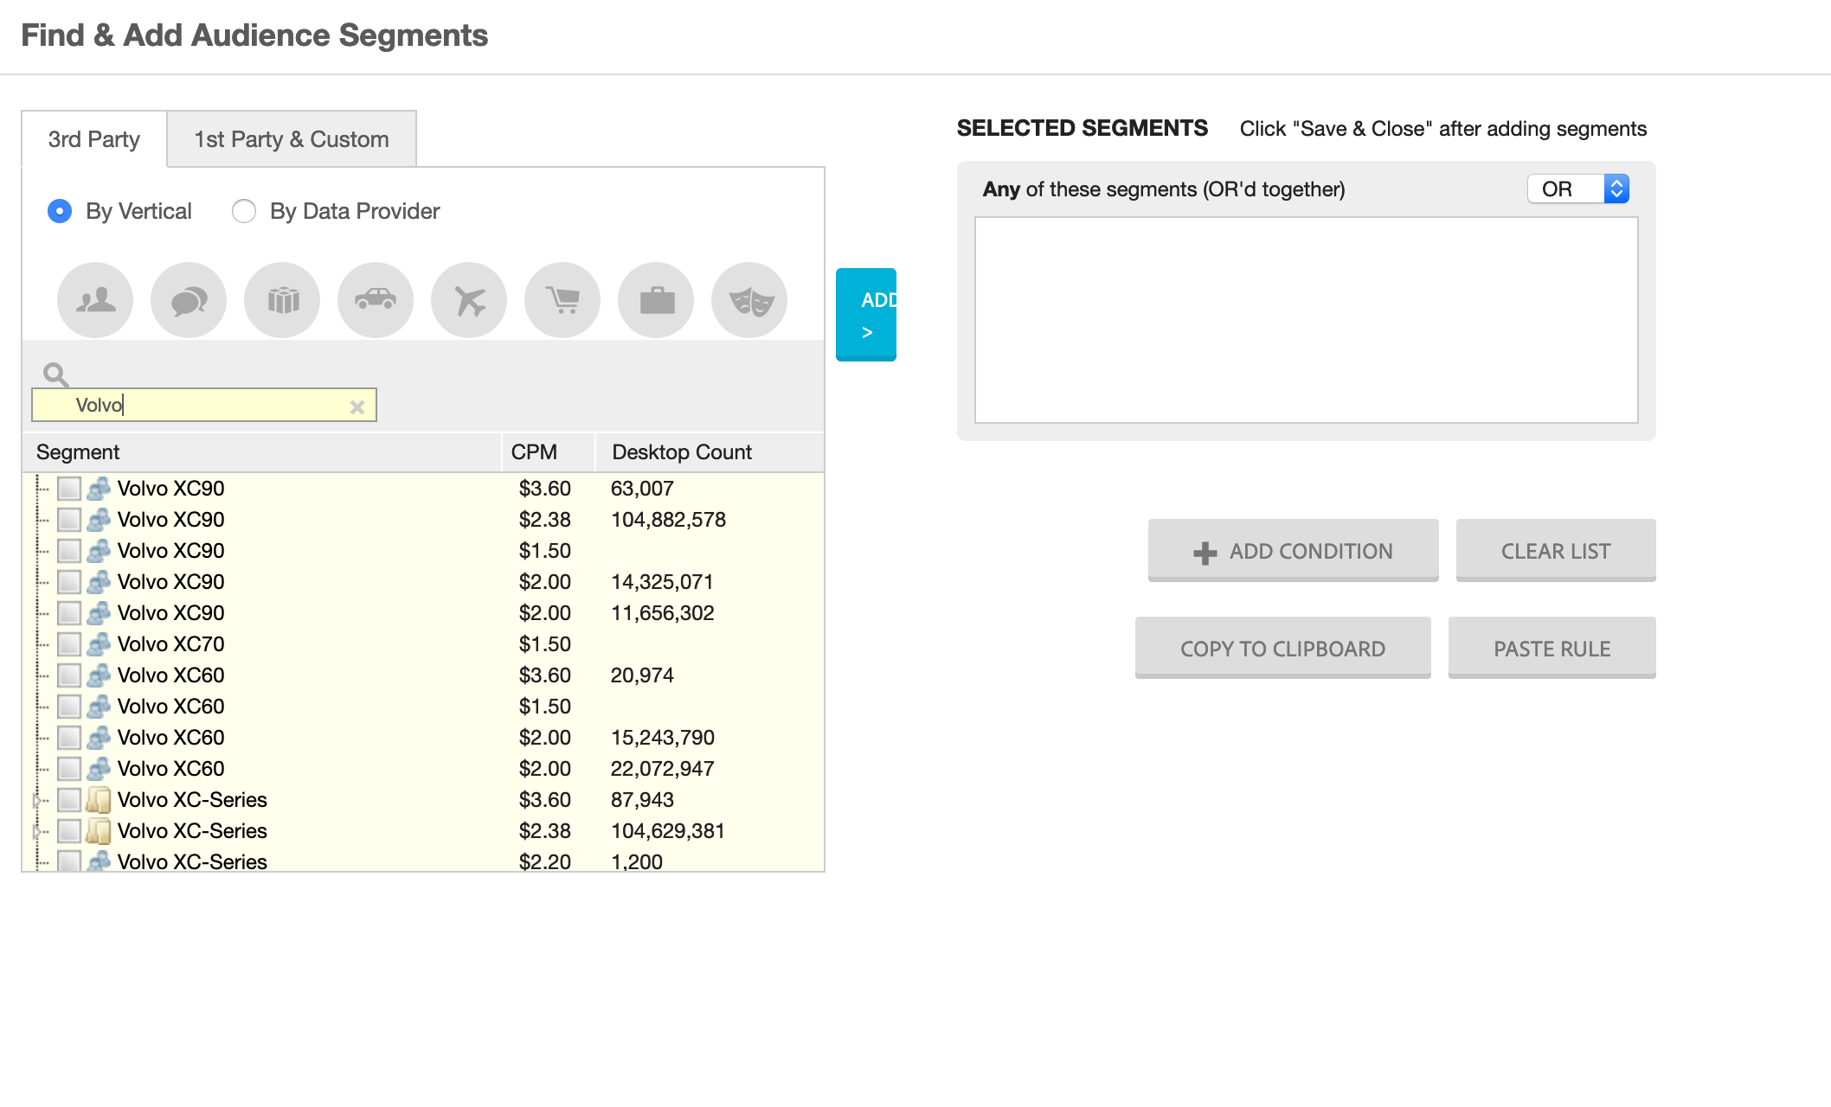
Placing Digital Ads 101
Auction Buying / Programmatic
Notes:
Josh
But based on our polling and other surveying we know that Republicans who drive Volvos are really important for this ad creative.

Slide 12
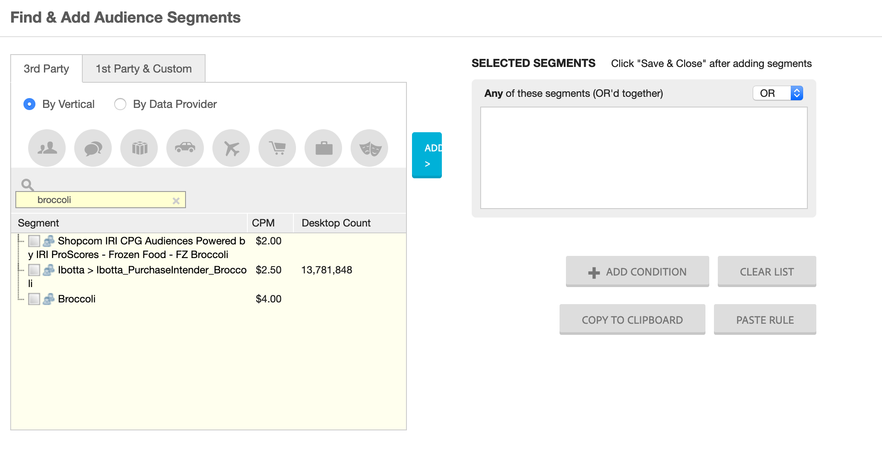
Placing Digital Ads 101
Auction Buying / Programmatic
Notes:
Josh
But even more important are Volvo driving, Broccoli eating Republicans.

Slide 13
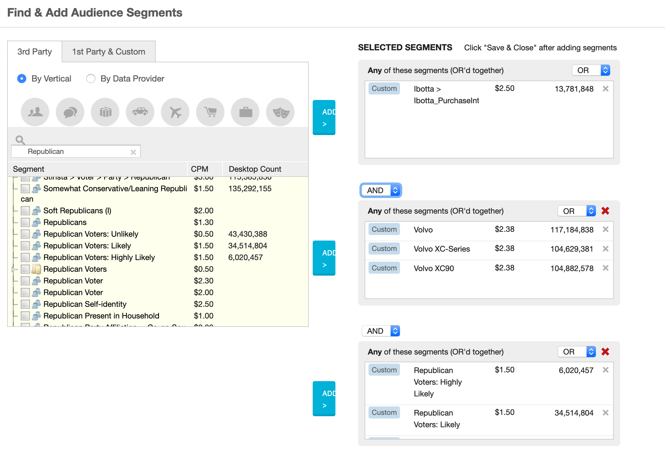
Placing Digital Ads 101
Auction Buying / Programmatic
Notes:
Josh
Most platforms allow this kind of targeting, some do it better than others. It’s important to note, as we’ll get to later, I did not limit my targeting based on age or gender. But, if my system shows analytics that has it I must report those things -- even if age and gender had no bearing on my ad buy. This could give the wrong impression to those who look into our ad buys.

Slide 14
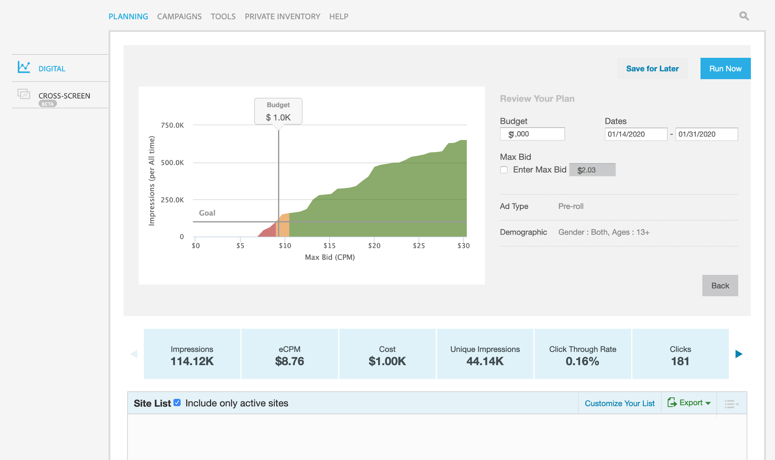
Placing Digital Ads 101
Auction Buying / Programmatic
Notes:
Josh
And based on our targeting we can expect to have roughly 115,000 impressions over a two week period. I wont know the names of the people we reached, and its very hard to determine the number of people we reached as the 44,000 Unique impressions were unique devices based within a certain time frame.

Slide 15
Placing Digital Ads 101
Direct Buy
Publisher Run Campaign
Advertiser Run Campaign via DealID
Auction Buying/Programmatic
Social Media/Native
Most websites
Notes:
Josh
So far we’ve gone over a direct by campaign, programmatic (which is how you get your ads on most websites and social media). Next up is Premium Inventory or a mix between direct buy and programmatic.

Slide 16
Placing Digital Ads 101
Mixed / Premium
Notes:
Josh
Here’s quick screen recording of the types of premium inventory available to us. I can go to just about any of these companies and negotiate for a Deal ID or I can use this system within my platform. The challenge for transparency is it’s hard to know who to go for to find this information. A lot of these are “cable channels” but I can buy them here for their online platforms. I think it’s unrealistic and not transparent to make a voter become Sherlock Holmes to figure out who has the book of business in this scenario.

Slide 17
Placing Digital Ads 101
Direct Buy
Publisher Run Campaign
Advertiser Run Campaign via DealID
Auction/Programmatic Buying
Social Media/Native
Most websites
Mixed Buying
Premium Advertisers
Notes:
Josh
So we have direct buy, programmatic buying and premium advertising. Next, we’ll go over the systems involved that make programmatic buying work.

Slide 18
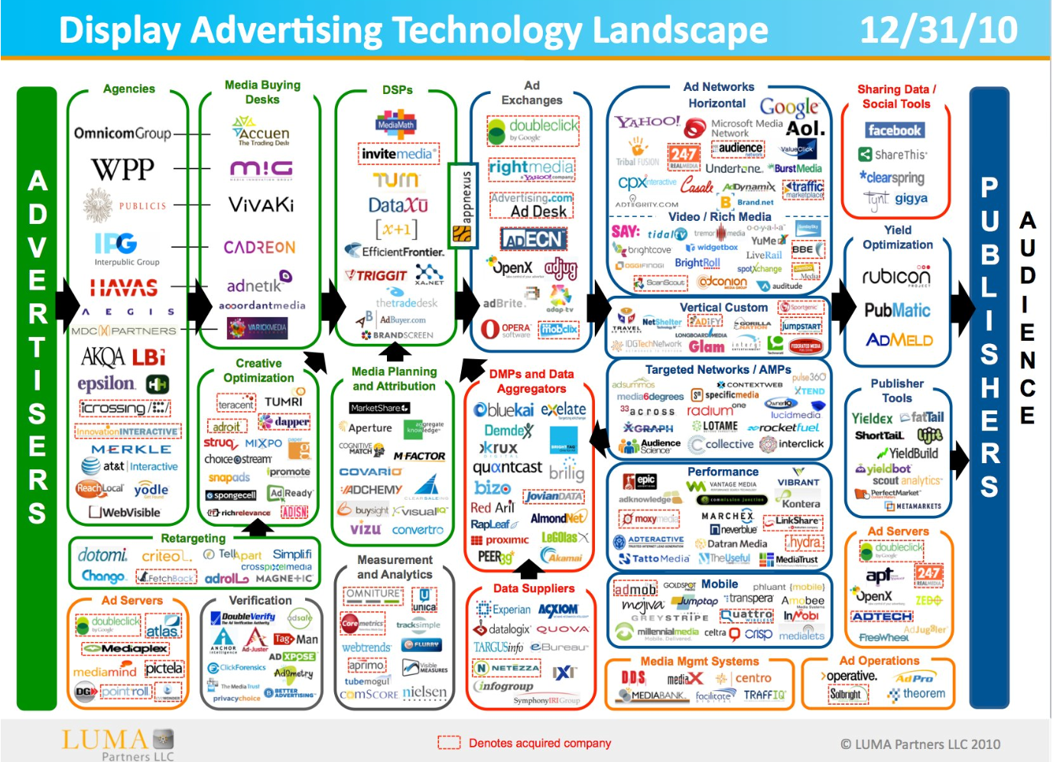
Ad Buying Ecosystem & How It Works
Advertiser
Demand Side Platforms
Data/Audience Networks
Notes:
Josh - Ad Buying Ecosystem and How It Works
Advertiser
The advertiser would be considered the campaign committee while a vendor like us would be considered a placement service.
Demand Side Platforms
Demand Side Platforms allow agencies like ours to place ads. Right now it seems the law would say the DSP is the “commercial advertiser” and they must maintain a book of business. According to a May 2018 survey from Pathmatics, the average advertiser uses 3 DSPs — likely because of the differing features. However, just because an ad is placed through a DSP it doesn’t mean that DSP has all of the buy information. A DSP allows an advertiser to have access to just about all inventory available and supply reports. The data available in the reports is variable, however, depending on the type of ads you’re placing and how they’re being placed. There are dozens of DSPs available, both foreign and domestic, new ones form and fail all the time.
Ad Server
An ad server can be used alongside a DSP to host the actual ad creative and measure information like clicks, impressions, etc. If an advertiser or placement service is using an Ad Server, the DSP would negotiate the purchase of the ad spot and the ad server would deliver the ad. In this instance, there are two systems who are acting as the ‘commercial advertiser’ and to have all information available to the public they would need to go to both places. Also — it’s nearly impossible for the average person to know that a campaign is using an Ad Server. A vendor, like me, might not even bill a campaign for our use of an ad server and just count it as part of our placement fee — after all, we don’t itemize for office space, Quickbooks, project management tools as it’s just overhead.
Data/Audience Networks
Audience and data networks are just as much a part of the ad buying process. Many times, we can buy audiences through the DSP with the DSP acting as a reseller of data. However, there are other times I will buy private audience segments and the segments are made available to me through the DSP. So, while DSP might report that the ad buy cost $250, it might have really been $275 with data charges.

Slide 19
Ad Buying Ecosystem Cont.
Ad Exchanges & Networks
Supply Side Platforms
Publisher
Notes:
Josh - Supply Side Platforms
Exchanges / Ad Networks
These two are different types of systems, but the short explanation of them is they both make inventory available to advertisers, usually through DSPs. However, you can go to ad networks directly to make ad buys. It’s important to note that in order for DSPs to make ad buys, the Exchanges and Ad Networks make APIs available. This means that someone with the resources could ‘go rogue’ to get around the commercial advertiser requirement build their own simple DSP to buy ads through the DSP and no one would know.
Supply Side Platforms
These systems are what websites use to make their ad inventory available to ad networks and ad exchanges. They typically expose their inventory to multiple networks and exchanges.
Publisher
Publishers are any website that sells advertising space. Publishers can make all of their inventory available through their SSP to an Exchange or Network and they can also use their SSP to sell direct to advertisers. Let’s say I’m an advertiser buying ad space with a goal of finding new campaign supporters. I notice ExampleWebsite.com is giving me way better results. I could go to ExampleWebsite.com and negotiate a direct buy deal that is managed through my DSP (using the Deal ID system we discussed before). In this instance, the DSP would be making the placement, but the payment would be happening direct with the publisher while I’d still be paying a fee to the DSP. If the campaign is large and long enough, I could end with multiple direct deals with publishers — many of which may not be U.S. based. This increases the complexity for maintaining a ‘book of business’

Slide 20
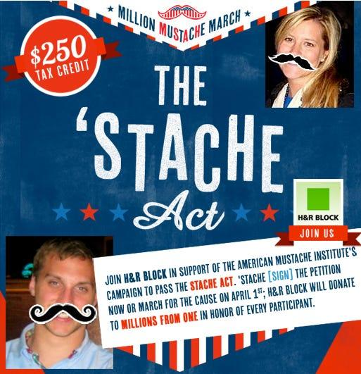
Enforcement & Awareness Challenges
Identifying “political” ads
Human Review?
Knowledge of Laws
Game the System
Notes:
Josh -
Identifying “political” Ads
Currently, digital advertisers, no matter their location, must be aware of a political ad being purchased on their system and that the political ad is regulated by Washington State. However, ads on almost all platforms go through automated review and approval. Depending on the design, machine reading text can be very difficult, especially at scale. How well can a computer determine an ad about “taxes” isn’t from a tax filing service and not a candidate?
Human Review
Billions of ads are placed each day, the size of the ad buying economy is too big for human review of every ad — which they would have to do to find political ads regulated by Washington State. Even if human review were possible, I don’t believe it’s reasonable to expect human reviewers to be trained on all the municipal, state, and federal election reporting requirements. There are too many Ad Networks and Exchanges (forming and failing all the time) to make a special exceptions in their programs for perhaps hundreds of local regulations that could change at any time. There’s a reason global consortiums exist for tech. Without standards, nothing would work together and our technology systems would fail.
Knowledge of Laws
We live in a global economy and it’s not practical for one state’s regulatory entity to place regulations on companies in other states and nations. The likelihood they would even know of the law is small. Even if they did, the financial upside to accept ads would be minimal for any company that does have the resources to comply with our specific regulations while the limitation placed on Washington state campaigns from advertisers opting out would be huge. Companies like Facebook & Google have opted out of our system and if anyone has the financial and engineering capacity to comply it’s them. The only reason all the other companies haven’t opted-out is because they haven’t been targeted for enforcement.
Game the System
It’s important to recognize that it’s super easy to game this system. If there’s a campaign that wants to run ads, digital or otherwise, without proper disclosure it can be done. We think that transparency is critical to trust in our elections and democracy and strongly believe we need a system that actually works — the current one does not.

Slide 21
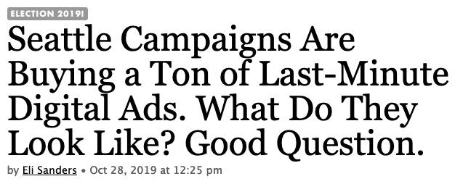
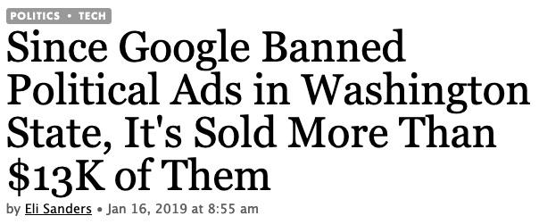
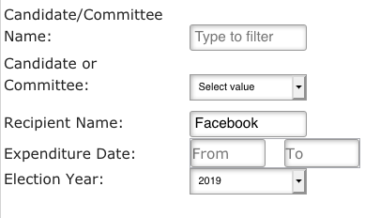
Creating Confusion
= $66,825
Notes:
Erin - It seems to me that the laws regarding disclosure of advertisers is to bring greater transparency and clarity, but our current situation is creating more confusion than anything.
Facebook advertising in the 2019 elections is one clear example. Although Facebook announced it would stop selling political ads in Washington State as a result of disclosure laws, a simple search on the PDC site shows that there were 237 reports to the PDC of advertising on Facebook and over $66,000 spent.
This creates an unfair disadvantage for candidates and campaigns who are working within WA digital advertising limitations.
In addition to confusing campaigns, possibly the greatest issue is the confusion this creates among voters and the general public.
Last year, campaigns had voters reach out to them that their opponents are advertising on Facebook which is illegal in Washington State and they should report them.

Slide 22
The Problem
Disadvantages state and local campaigns
Regulations are unworkable
System in place
Sponsor ID
Reporting
Notes:
Erin & Josh -
Limiting campaigns’ ability to communicate online unfairly disadvantages state and local campaigns
Current requirements are outdated and unworkable given technology
WA has a robust system to ensure transparency through sponsor identification and expenditure reporting

Slide 23
The Solution?
Campaigns Report Ad Placements
Media Upload
Amount of ad buy
Planned flight dates
Estimated/Actual Impressions or Reach
Similar to current C6 filings. Verification can be handled on as-needed basis.
Consider removing granular reporting
Unequal reporting available on platforms
Doesn’t get to the “why”
Not required of other mediums

