Slide 1
Why disclosure of digital advertising is important
Travis N. Ridout
Co-director, Wesleyan Media Project
Thomas S. Foley Distinguished Professor of Government and Public Policy
Washington State University

Slide 2
Wesleyan Media Project
Founded in 2010
Collaboration of WSU, Wesleyan and Bowdoin
Tracks local broadcast TV advertising, national cable and national broadcast, Facebook and other digital, radio
Goal is transparency

Slide 3
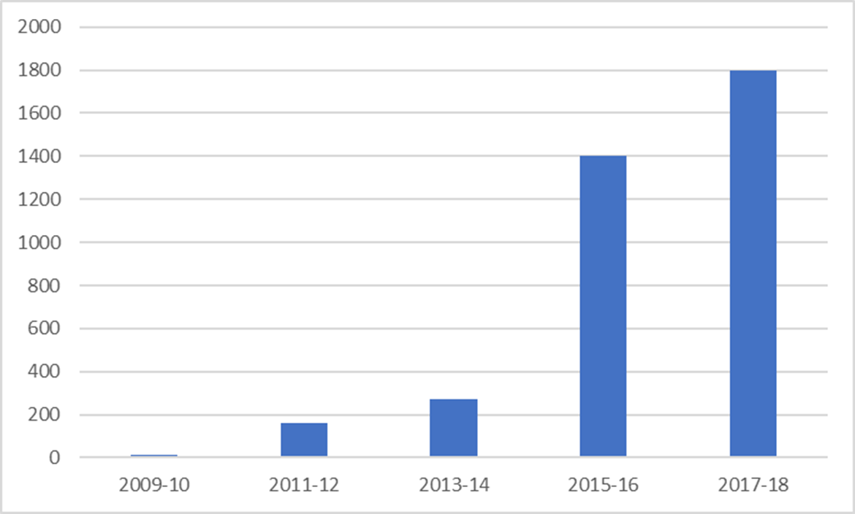
Digital ad spending ($ millions)

Slide 4
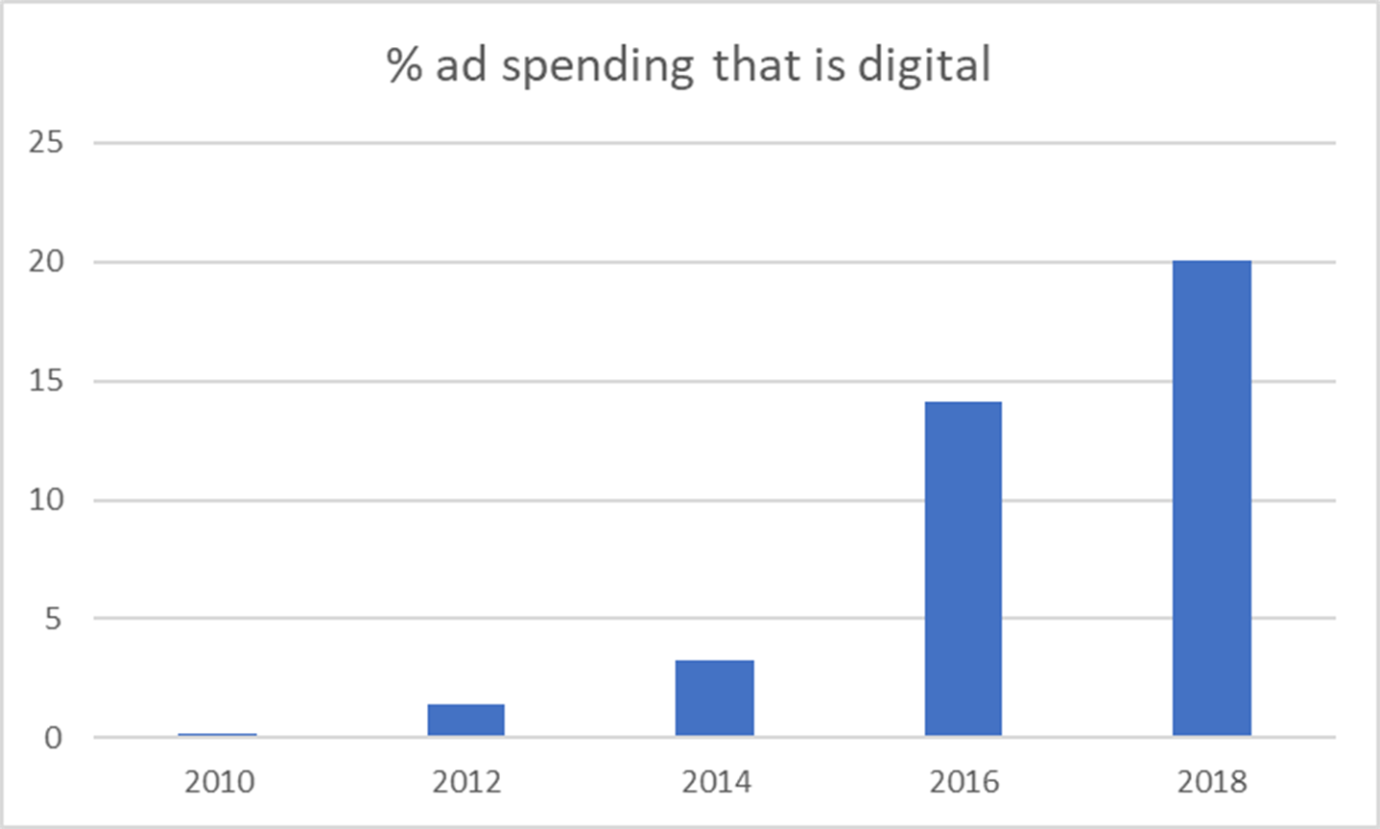

Slide 5
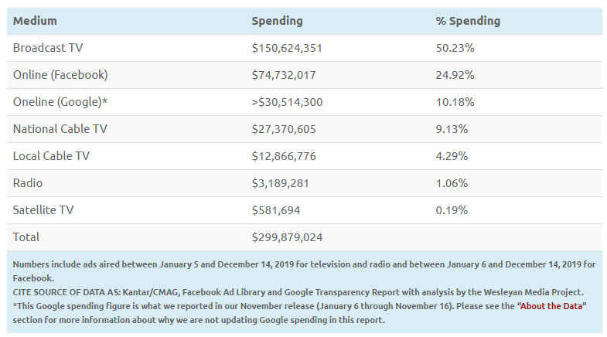
Presidential candidate ad spending by medium (2019-2020)

Slide 6
What’s the merit of transparency?
Courts have identified three rationales for disclosure
- to help enforce campaign finance law
- to combat corruption or its appearance
- to provide voters with information that can help them vote their interests

Slide 7
So is disclosure actually useful to voters?

Slide 8
Survey: voters like disclosure
Data from 2015 CCES

Slide 9
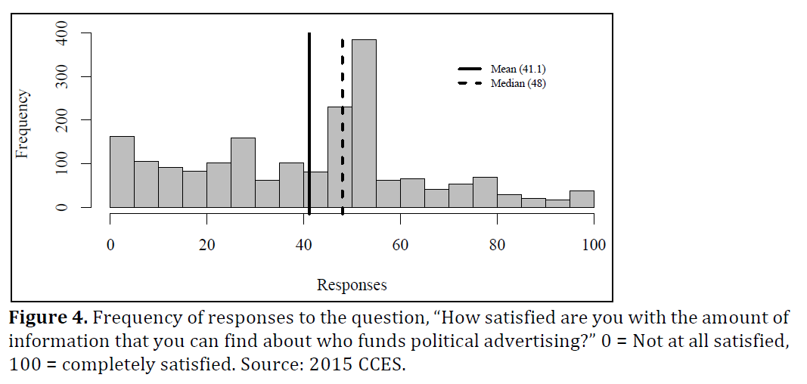
Survey: voters claim to want more info
From Wood (2018)

Slide 10
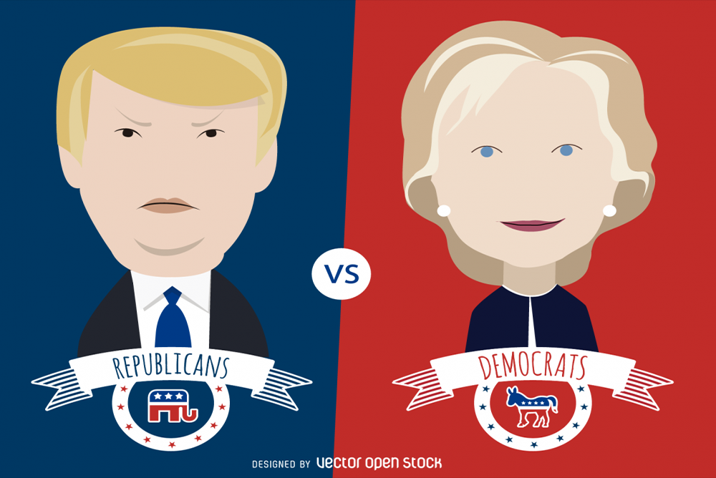
Experiment: Wood (2018)
Vignette featuring two candidates
- Johnson: Transparency grade of C; supported by groups
with anonymous donors
- Conley: Transparency grade of A; “over-discloses”
Upshot: Voters reward transparency
- More transparent candidate rated 14 points more favorably on 100 point scale
- Effect driven more by punishing than rewarding
Mechanism is trust: transparency engenders voter trust

Slide 11
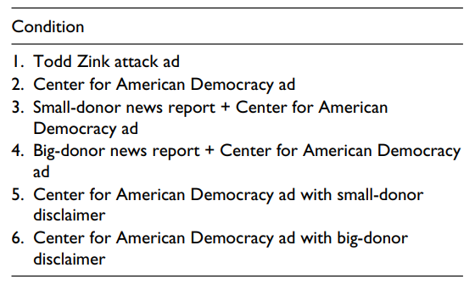
Experiment: Ridout, et al. (2015)
Featured attack ad with various types of disclosure:

Slide 12
Findings
Ads sponsored by unknown groups are more effective than candidate sponsored ads
- i.e., voters find “Americans for a Better America” ads more persuasive than candidate-sponsored ads
BUT disclosure of donors reduces the influence of group advertising, leveling the playing field such that candidate- and group-sponsored attacks become equally effective.

Slide 13
What are the key differences between digital and other types of advertisers that regulators and policy-makers should be thoughtful about?
Speed
Cost
Different/multiple goals
Less trustworthy speakers on digital than TV

Slide 14
How have state laws not kept up with what the needs are, given today’s landscape?

Slide 15
What are the barriers to getting the public information as quickly and comprehensively as possible?

Slide 16
Would it be a good path to have filer reporting requirements cover the types of information that advertisers are asked to report?

