Slide 1

Regulatory Concerns for Facebook Political Advertising
Presenter Name Here
Date Here

Slide 2
Digital Ads

Slide 3
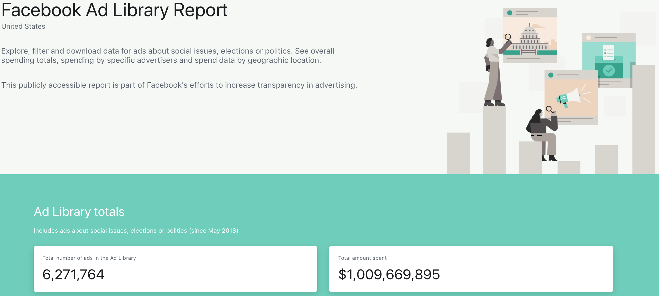

Slide 4
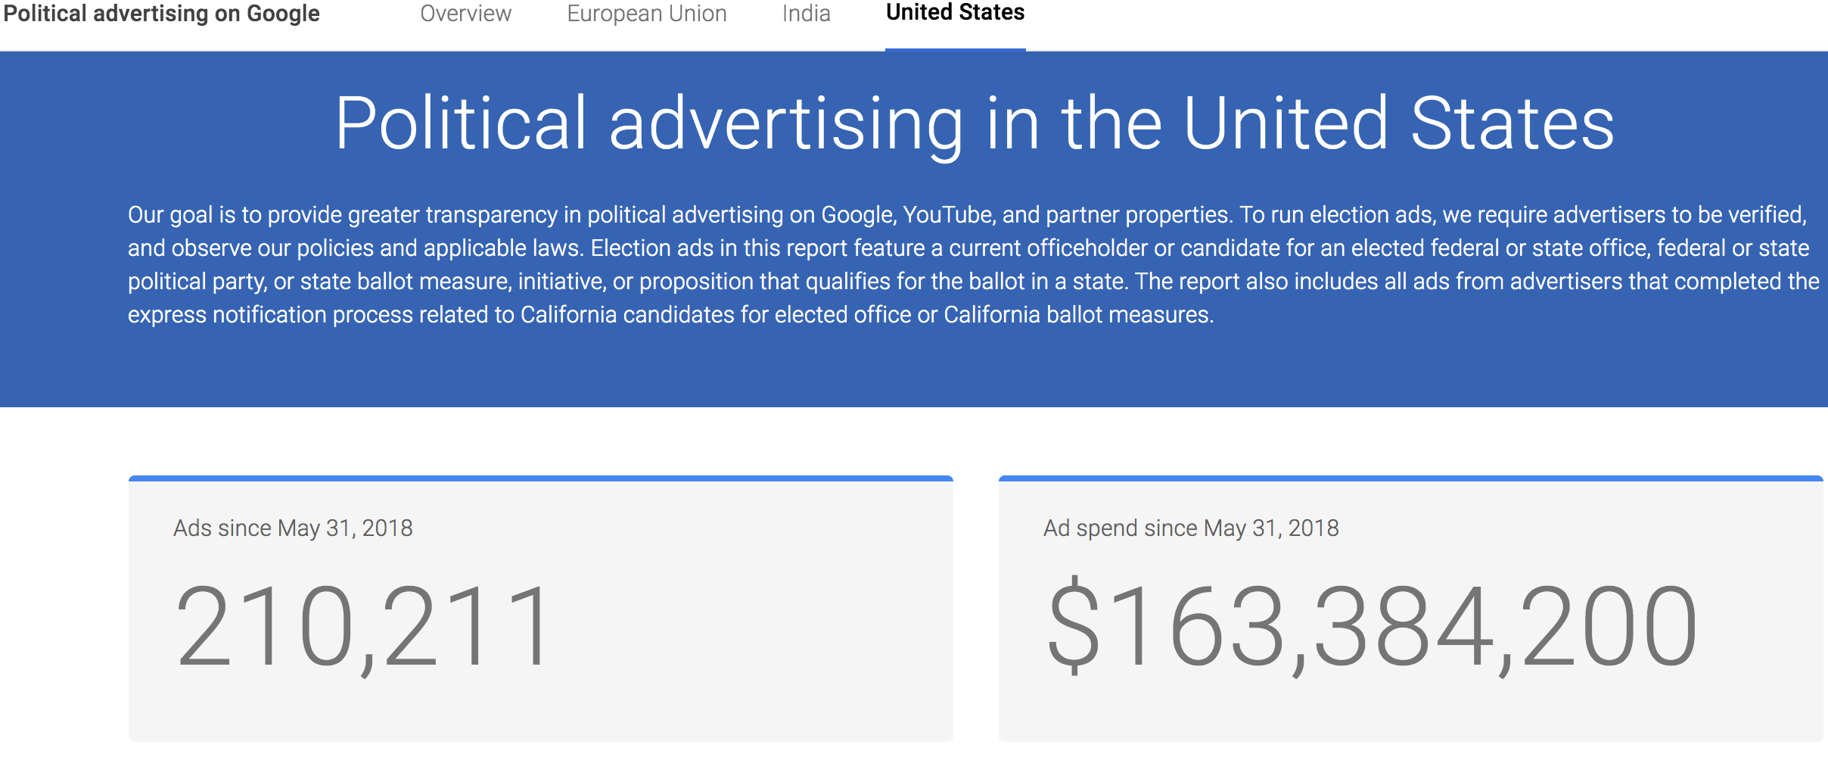

Slide 5
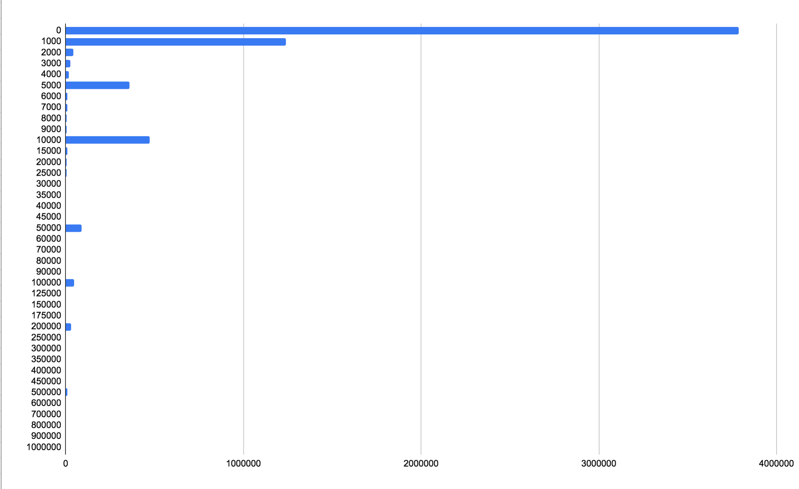
Distribution of
Minimum
Impressions
per Facebook Ad

Slide 6
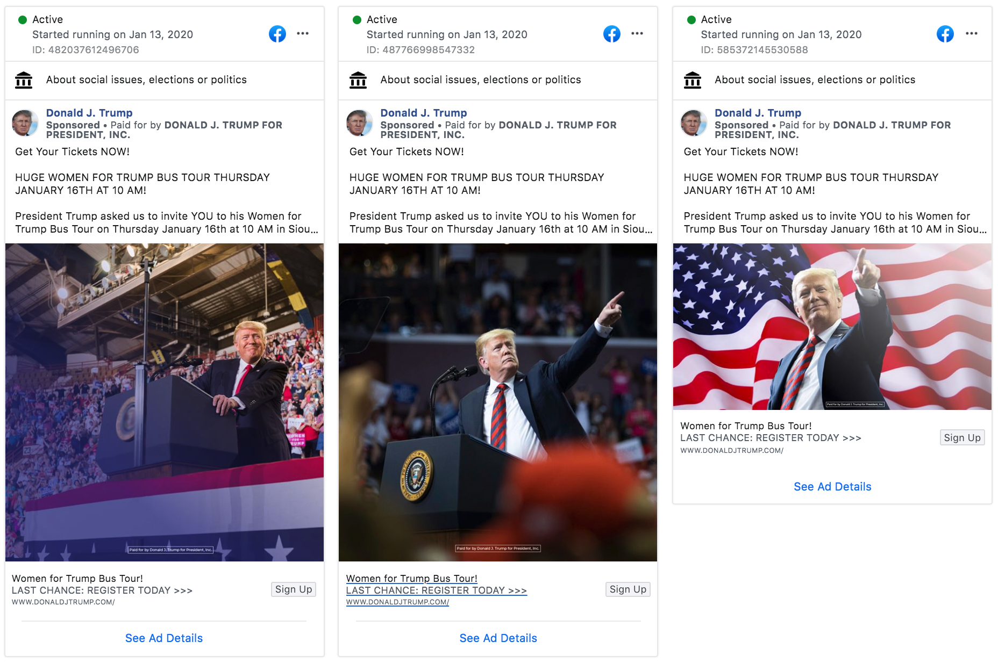

Slide 7
Since January 1st, 2020:
126,800 ads
22,924 distinct texts
~9,000 text clusters

Slide 8
Reporting and Transparency Problems

Slide 9


Slide 10
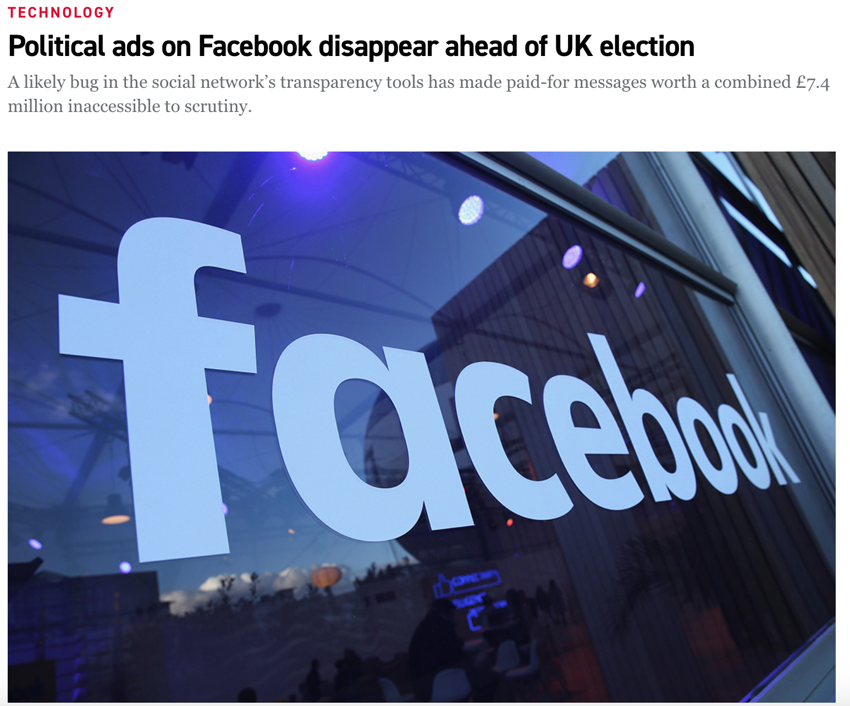


Slide 11
8% of ads in the Facebook Ad Library do not disclose their payer
54% of pages that run ads NEVER provide a disclosure string

Slide 12
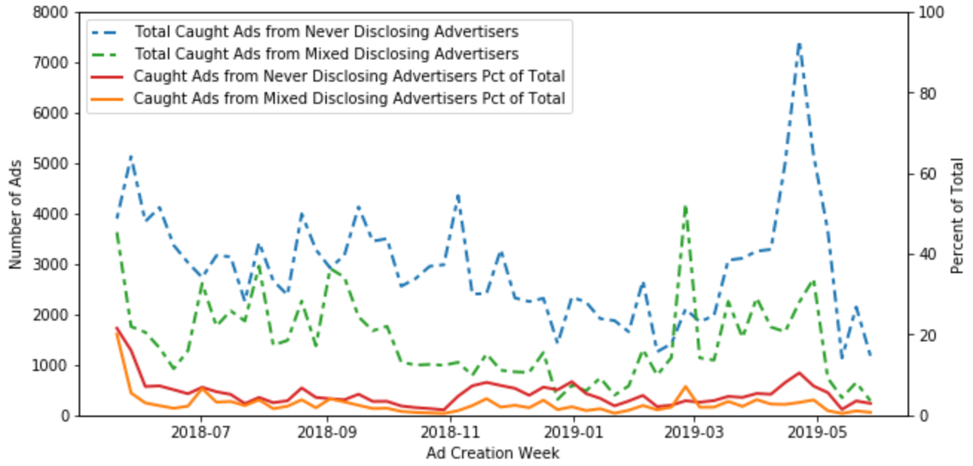

Slide 13
Disclosure String Problems

Slide 14
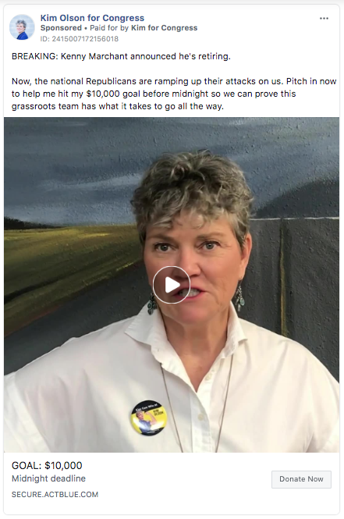
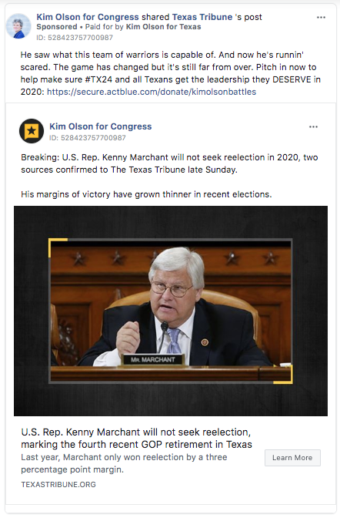


Slide 15
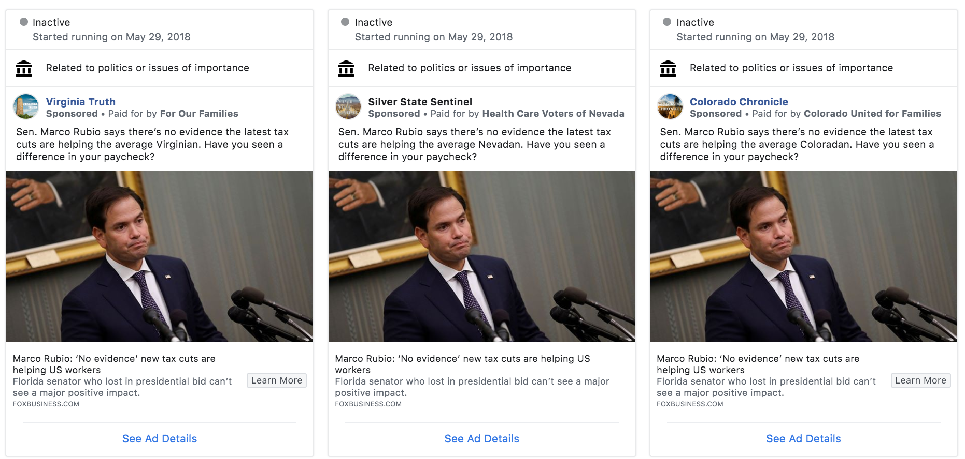

Slide 16
