Slide 1
Big Data, Big Dollars:
Shining Light on Digital Political Advertising
Denise Roth Barber, Managing Director
National Institute On Money In Politics
FollowTheMoney.org

Slide 2
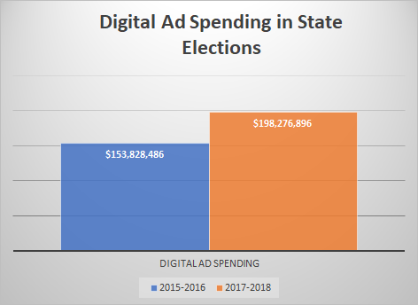
Contributions
Notes:
Campaigns are increasingly using digital advertising
Identifiable digital ad spending was 6% of total expenditures in 2015-2016; 4% of total in 2017-2018

Slide 3
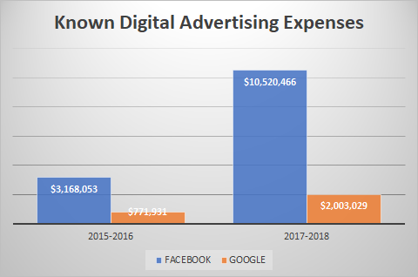
Notes:
Known = identifiable. Reporting is sloppy enough that it is possible/likely additional spending occurred but was not identified properly
NIMP dataset has expenditure files in 38 states.

Slide 4
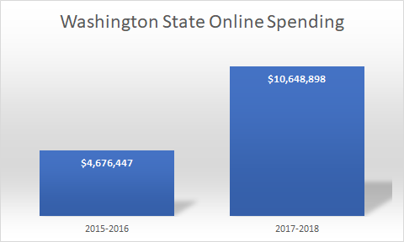

Slide 5
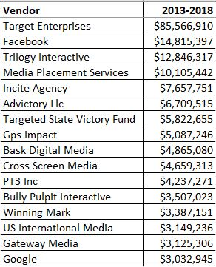
Top Online Digital Advertisers
Contributions
Notes:
For Target Enterprises, $81.7 m was spent in CA & includes print, tel & radio , but were not itemized in the file we obtained from the state
Target Enterprises spent $3.6 m in WA in 2018

Slide 6
The courts have consistently ruled that disclosure does not violate Free Speech rights

Slide 7
Justice Antonin Scalia, in the Doe v. Reed case:
Although the court acknowledges an individual’s right to anonymity, that right can be denied in some instances because of the State’s interest in “preserving the integrity of the electoral process,”
“a long history of practice shows that the First Amendment does not prohibit public disclosure.”
“Our Nation’s longstanding traditions of legislating and voting in public refute the claim that the First Amendment accords a right to anonymity in the performance of an act with governmental effect.”
“A governmental practice that has become general throughout the United States, and particularly one that has the validation of long, accepted usage, bears a strong presumption of constitutionality.” McIntyre, supra, at 375 (SCALIA, J., dissenting).
“Requiring people to stand up in public for their political acts fosters civic courage, without which democracy is doomed,”
Contributions
Notes:
2010 Case Doe v. Reed: Disclosure of the identity of persons who sign petitions for ballot referenda does not normally violate the First Amendment. The Court leaves open, however, the question whether the First Amendment might prohibit disclosure if it can be shown that disclosure could expose those who signed a petition to serious harm.

Slide 8
Justice Kennedy, 2010 Supreme Court’s Citizens United Ruling
“The First Amendment protects political speech, and disclosure permits citizens and shareholders to react to the speech of corporate entities in a proper way.
“With the advent of the internet, prompt disclosure of expenditures can provide shareholders and citizens with the information needed to hold corporations and elected officials accountable for their positions and supporters.
Disclosure “provide[s] the electorate with information,” makes sure “that voters are fully informed about the person or group who is speaking,” and ensures people are “able to evaluate the arguments to which they are being subjected.”
Contributions

Slide 9
As with all disclosure, the information required to be disclosed must be:
timely
accessible
digitally searchable (scanned images don’t count in 2020!), and
in practice, not just on the books

Slide 10

Questions?
Denise Roth Barber
deniser@followthemoney.org
(406) 449-2480

