Slide 1


DAA: Industry Coordination on Political Advertising Transparency
Washington Public Disclosure Commission, Special Meeting: Shining Light on Digital Political Advertising

Slide 2
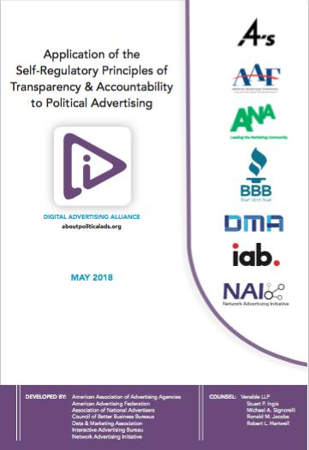
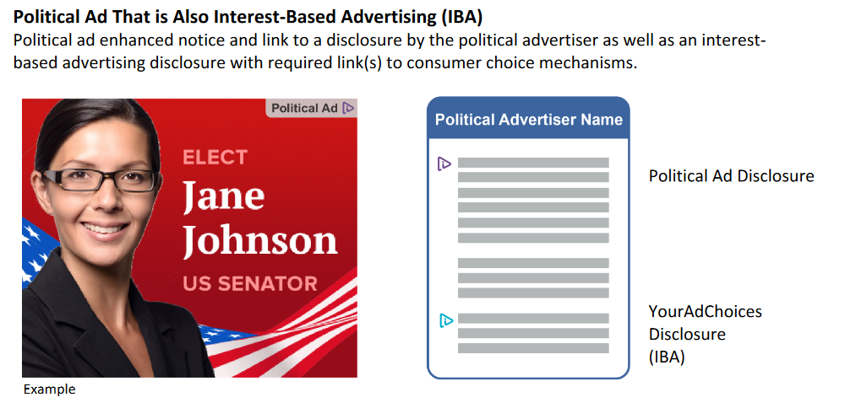

Notes:
LM

Slide 3
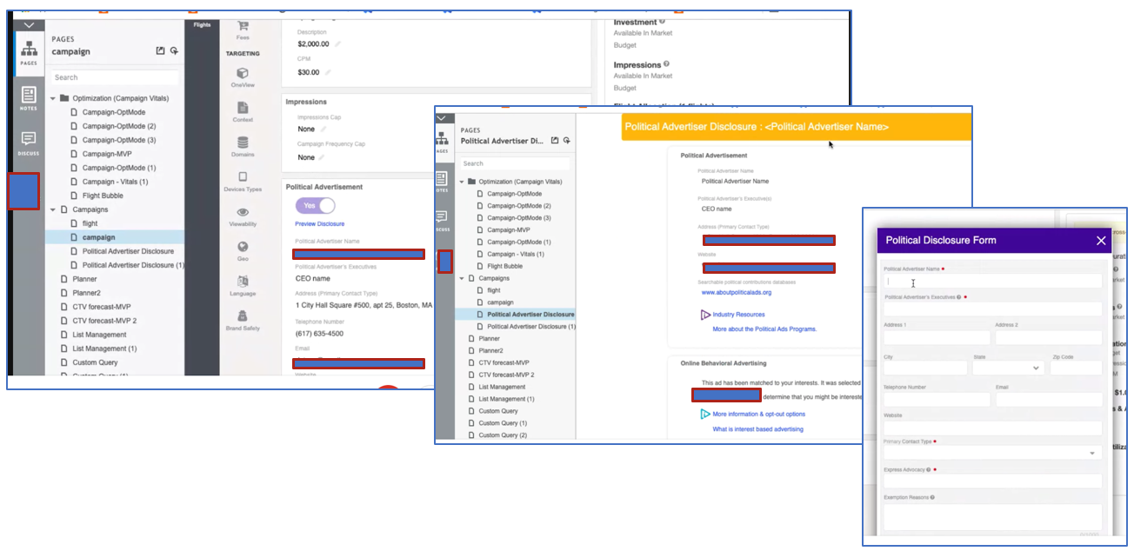
How One Programmatic Platform is Implementing the Transparency Program
Platform-level Compliance with DAA PoliticalAds

Slide 4

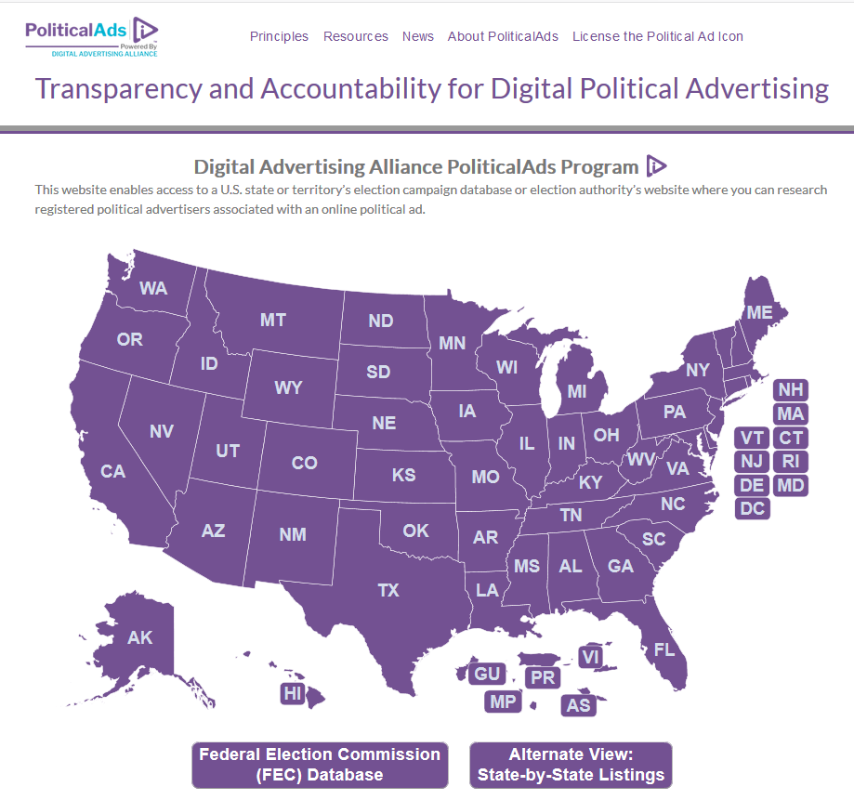
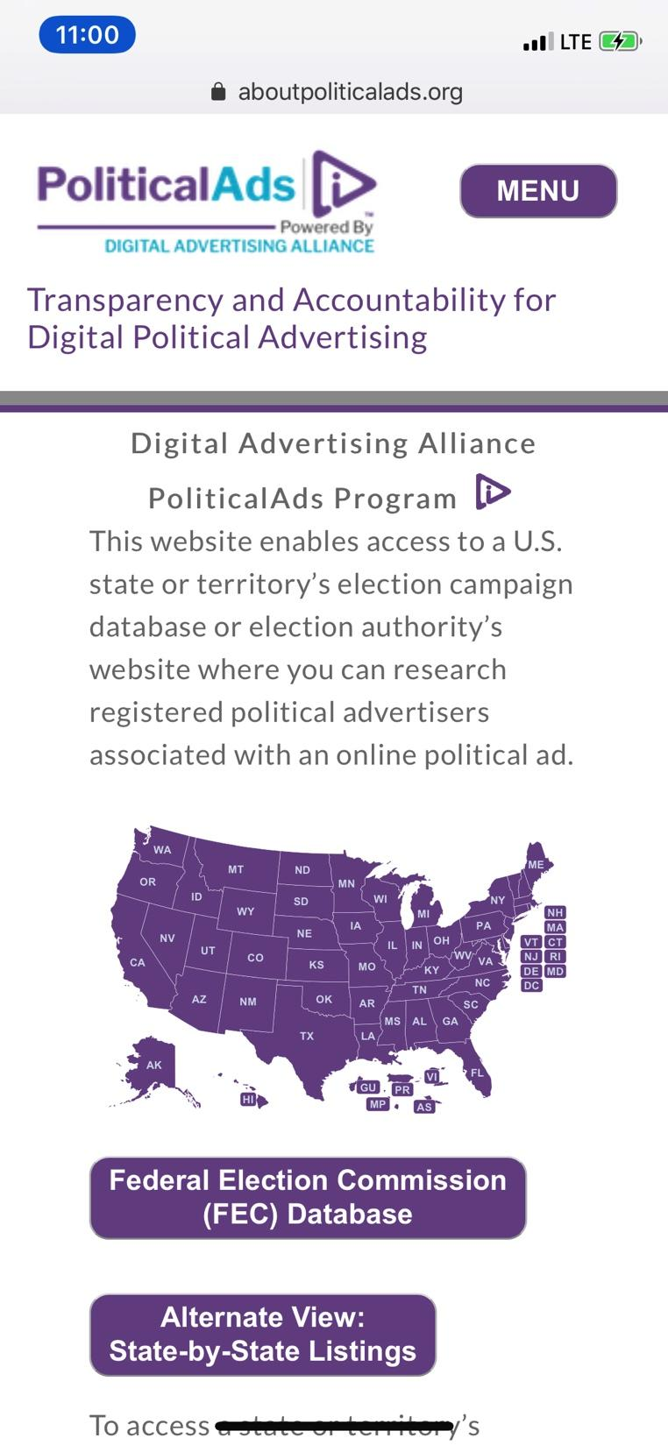
AboutPoliticalAds.org | Your Interface with Voters
Notes:
LM - Hey voters: the DAA team continues to keep our voter-lookup data base up to date and connected!

Slide 5
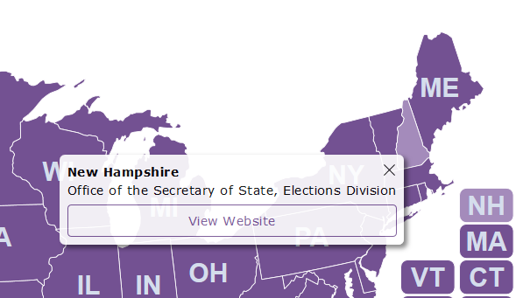
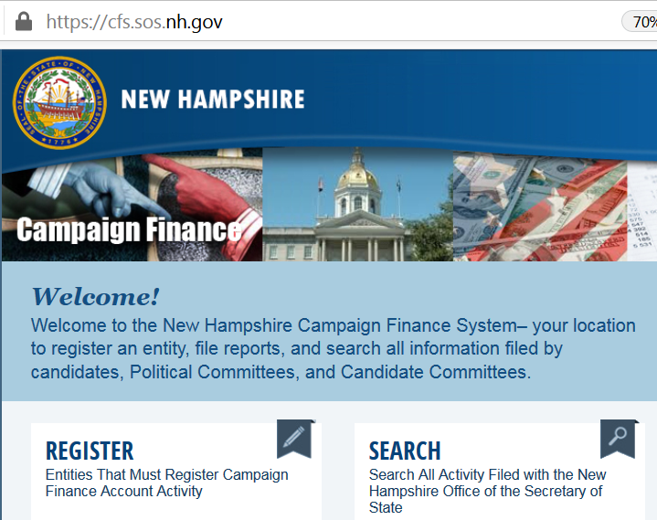
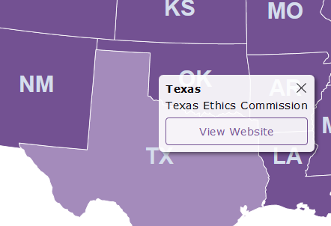
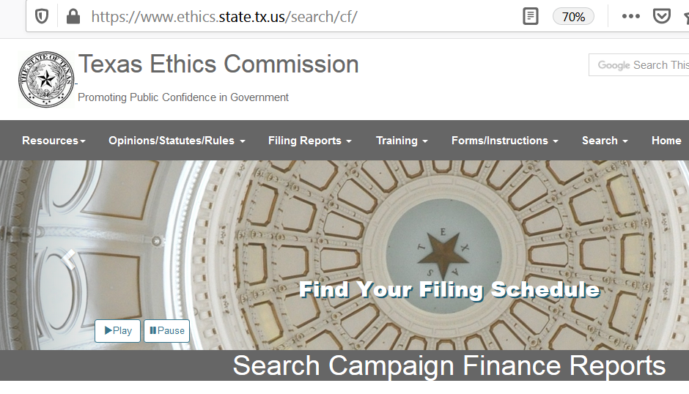
DAA Voter-Citizen Resources:
Express Advocacy Look-Up | aboutpoliticalads.org
Notes:
LP – This enables voters to link directly (via a new window) to each state (and territory) secretary of state and/or election commission campaign finance and spending database to validate any specific express advocacy ad entity.

Slide 6
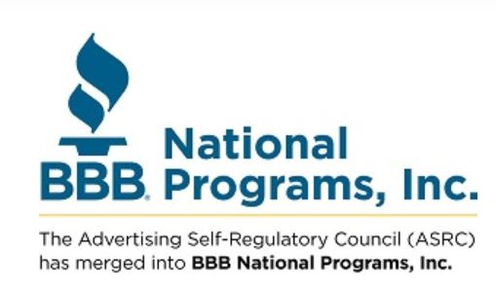

DAA’s Accountability Partners – Ready to Enforce & Answer Questions
The new guidelines took effect on November 1, 2019, and enforcement of compliance begins January 1, 2020.

